Slide 1
Chapter 6: Recommendation Systems

Slide 2
Outlines
Introduction to recommender systems
A Model for Recommendation Systems
Content-based filtering
Collaborative filtering

Slide 3





Introduction to recommender systems
Recommender Systems (RSs) recommend to their users personalized and ranked lists of items.
Search
Recommendations
Items
Products, web sites, blogs, news items, …
Source: https://web.stanford.edu/class/cs246/

Slide 4
Introduction to recommender systems
Two main groups:
Content-based systems examine properties of the items recommended.
For instance, if a Netflix user has watched many cowboy movies, then recommend a movie classified in the database as having the “cowboy” genre.
Collaborative filtering systems recommend items based on similarity measures between users and/or items. The items recommended to a user are those preferred by similar users.

Slide 5
A Model for Recommendation Systems

Slide 6
A Model for Recommendation Systems
The Utility Matrix
Two classes of entities: users and items.
Users have preferences for certain items, and these preferences must be teased out of the data.
The data itself is represented as a utility matrix, giving for each user-item pair, a value represents the degree of preference of that user for that item.

Slide 7
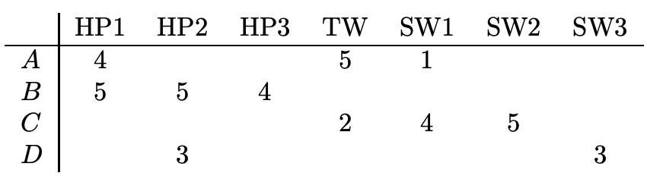
A Model for Recommendation Systems
The Utility Matrix
The goal of a recommendation system is to predict the blanks in the utility matrix.
Example:
A utility matrix represent users’ ratings of movies on a 1–5 scale, with 5 the highest rating. Blanks represent the situation where the user has not rated the movie.
The movie names are HP1, HP2, and HP3 for Harry Potter I, II, and III, TW for Twilight, and SW1, SW2, and SW3 for Star Wars episodes 1, 2, and 3. The users are represented by capital letters A through D.

Slide 8
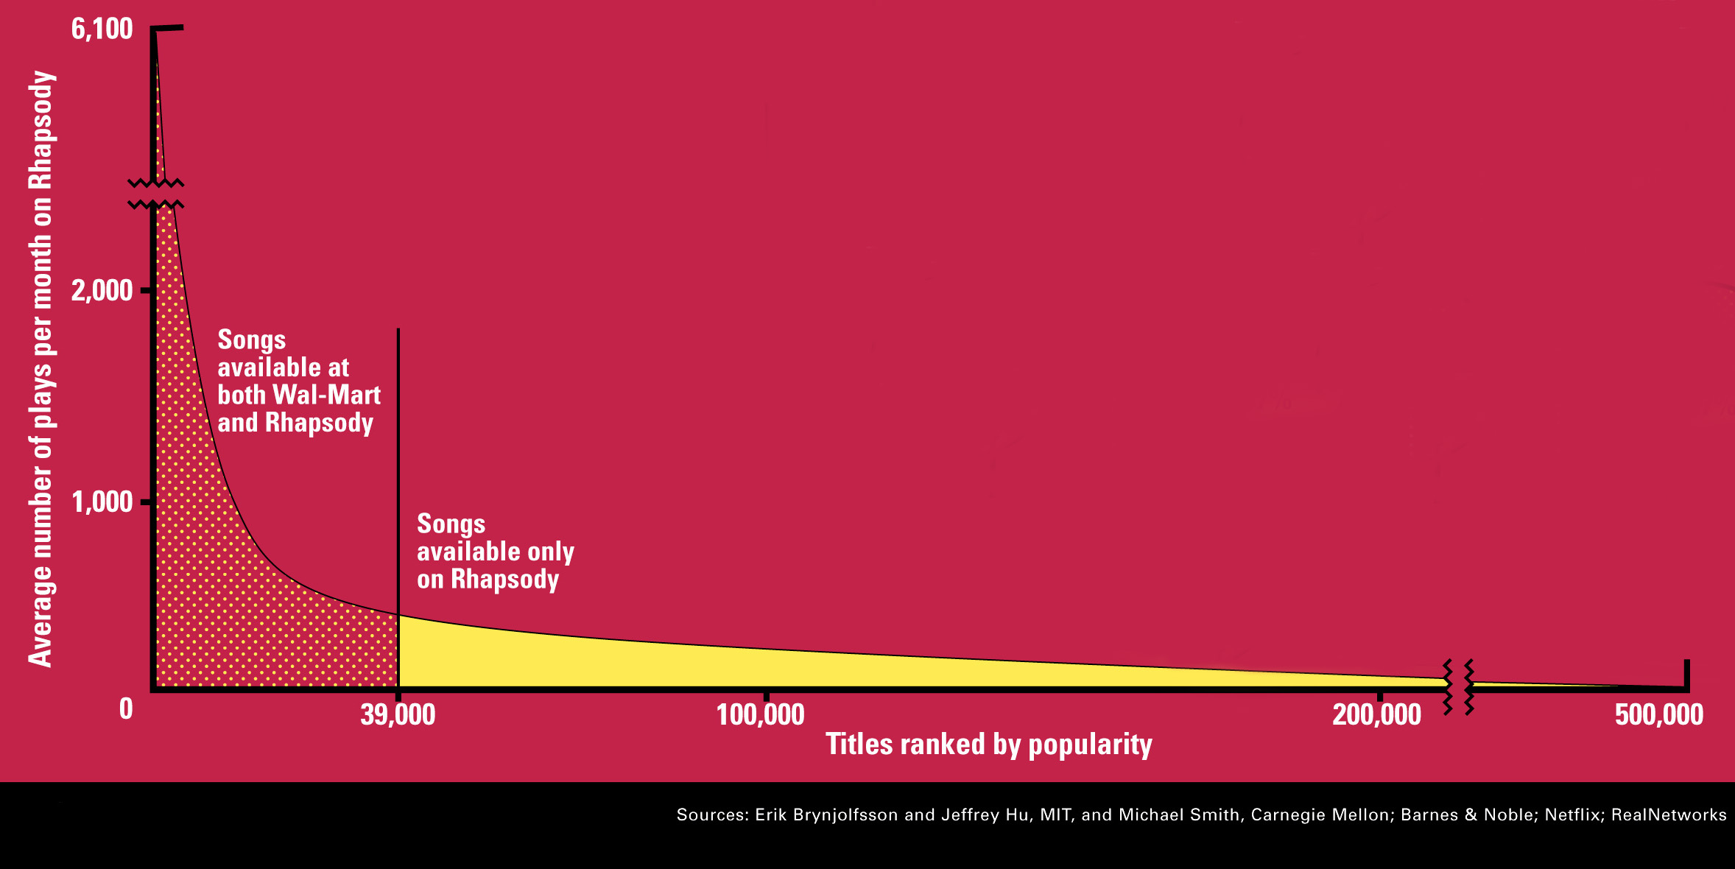
A Model for Recommendation Systems
The Long Tail
Recommendation in the physical world is fairly simple.
A bookstore will display only the books that are most popular
A newspaper will print only the articles it believes the most people will be interested in.
Physical institutions provide only the most popular items to the left of the vertical line, while the corresponding online institutions provide the entire range of items: the tail as well as the popular items.

Slide 9
A Model for Recommendation Systems
Populating the Utility Matrix
Acquiring data from which to build a utility matrix is often difficult.
Two general approaches discover the value users place on items.
We can ask users to rate items.
This approach is limited in its effectiveness, since generally users are unwilling to provide responses, and the information from those who do may be biased by the very fact that it comes from people willing to provide ratings.
We can make inferences from users’ behavior.
If a user buys a product at Amazon or views information about an item, watches a movie on YouTube, or reads a news article, then the user can be said to “like” this item.

Slide 10
Content-Based Recommendations

Slide 11
Content-Based Recommendations
Content-Based systems focus on properties of items. Similarity of items is determined by measuring the similarity in their properties.
Main idea:
Recommend items to customer x similar to previous items rated highly by x
Example:
Movie recommendations
Recommend movies with same actor(s), director, genre, …
Websites, blogs, news
Recommend other sites with “similar” content

Slide 12
Content-Based Recommendations
Item profiles
likes
build
recommend
match
Red
Circles
Triangles
User profile

Slide 13
Content-Based Recommendations
Item Profiles: collections of records representing important characteristics of that item.
Profile is a set (vector) of features
Movies: author, title, actor, director,…
Text: set of “important” words in document
How to pick important features?
Usual heuristic from text mining is TF-IDF
(Term frequency * Inverse Doc Frequency)

Slide 14
Content-Based Recommendations
Discovering Features of Documents
Eliminate stop words.
Compute the TF.IDF score for each word in the document.
Take the n words with the highest TF.IDF scores as features of the document.
To measure the similarity of two documents, there are several natural distance measures:
Jaccard distance
cosine distance

Slide 15
Content-Based Recommendations
Obtaining Item Features From Tags
Obtaining information about features of items by inviting users to tag the items by entering words or phrases that describe the item.
The problem with tagging as an approach to feature discovery is that the process only works if users are willing to take the trouble to create the tags, and there are enough tags that occasional erroneous ones will not bias the system too much

Slide 16
Content-Based Recommendations
User profile:
User has rated items with profiles i₁, …, i_{n}
Simple: (weighted) average of rated item profiles
Variation: normalize weights by difference from average rating of user
Some other sophisticated aggregations

Slide 17
Content-Based Recommendations
User Profiles
 | M1 | M2 | M3
U1 | 7 | 4 | 10
 | Fantasy | Action | Cartoon | Drama | Comedy
M1 | 0 | 0 | 1 | 0 | 1
M2 | 0 | 0 | 0 | 1 | 0
M3 | 1 | 0 | 0 | 0 | 1
User profile
 | Fantasy | Action | Cartoon | Drama | Comedy
U1

Slide 18
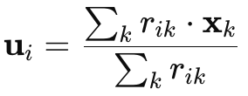
Content-Based Recommendations
 | U1
M1 | 7
M2 | 4
M3 | 10
 | Fantasy | Action | Cartoon | Drama | Comedy
M1 | 0 | 0 | 1 | 0 | 1
M2 | 0 | 0 | 0 | 1 | 0
M3 | 1 | 0 | 0 | 0 | 1
 | Fantasy | Action | Cartoon | Drama | Comedy
M1 | 0 | 0 | 7 | 0 | 7
M2 | 0 | 0 | 0 | 4 | 0
M3 | 10 | 0 | 0 | 0 | 10
 | Fantasy | Action | Cartoon | Drama | Comedy
U1 | 10 | 0 | 7 | 4 | 17
User profile

Slide 19
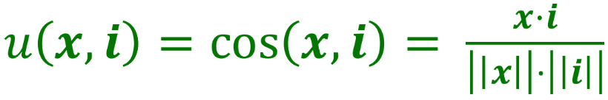
Content-Based Recommendations
Recommending Items to Users Based on Content
Prediction heuristic: Cosine similarity of user and item profiles
Given user profile x and item profile i, estimate

Slide 20
Content-Based Recommendations
Recommending Items to Users Based on Content
Prediction heuristic: Cosine similarity of user and item profiles
▪ Given user profile x and item profile i, estimate
 | Fantasy | Action | Cartoon | Drama | Comedy
M4 | 1 | 0 | 0 | 0 | 1
M5 | 0 | 1 | 0 | 1 | 0
(1*0.26 + 1*0.45)
sqrt(1+1) * sqrt(0.26^2 + 0.18^2 + … )
 | Fantasy | Action | Cartoon | Drama | Comedy
U1 | 0.26 | 0 | 0.18 | 0.11 | 0.45
 | Fantasy | Action | Cartoon | Drama | Comedy
U1 | 10 | 0 | 7 | 4 | 17

Slide 21
Content-Based Recommendations
Pros: Content-based Approach
+: No need for data on other users
No cold-start or sparsity problems
+: Able to recommend to users with unique tastes
+: Able to recommend new & unpopular items
No first-rater problem
+: Able to provide explanations
Can provide explanations of recommended items by listing content-features that caused an item to be recommended

Slide 22
Content-Based Recommendations
Cons: Content-based Approach
–: Finding the appropriate features is hard
E.g., images, movies, music
–: Recommendations for new users
How to build a user profile?
–: Overspecialization
Never recommends items outside user’s content profile
People might have multiple interests
Unable to exploit quality judgments of other users

Slide 23
Collaborative filtering

Slide 24
Collaborative filtering
Find similar users and recommend items that they like.
Comes in two flavors:
User-user collaborative filtering
Item-Item collaborative filtering

Slide 25
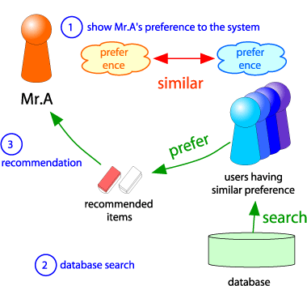
User-user collaborative filtering
Consider user x
Find set N of other users whose ratings
are “similar” to x’s ratings
Estimate x’s ratings based on ratings
of users in N

Slide 26
User-user collaborative filtering
Finding “Similar” Users
Represent users by their rows in the utility matrix
Two users are similar if their vectors are similar
Similarity Metric
Jaccard similarity measure
Cosine similarity measure
Pearson correlation coefficient

Slide 27

User-user collaborative filtering
Let r_{x} be the vector of user x’s ratings
Similarity Metric
Jaccard similarity measure
Problem: Ignores the value of the rating
rx =[1,_,_,1,3] ry =[1,_,2,2,_]
rx, ry as sets: rx = {1, 4, 5} ry = {1, 3, 4}

Slide 28
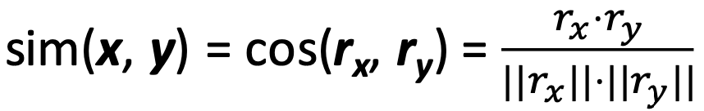
User-user collaborative filtering
Let r_{x} be the vector of user x’s ratings
Similarity Metric
Cosine similarity measure
Problem: This representation leads to unintuitive results.
rx =[1,_,_,1,3] ry =[1,_,2,2,_]
r_{x}, r_{y} as points:
r_{x} = {1, 0, 0, 1, 3}
r_{y} = {1, 0, 2, 2, 0}

Slide 29
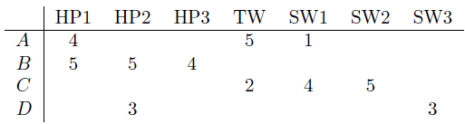
User-user collaborative filtering
Intuitively we want: J(A, B)?, J(A, C)?
Intuitively we want: sim(A, B) > sim(A, C)
sim(A, B) = ?
sim(A, C) = ?
Notes:
0.380 > 0.322

Slide 30
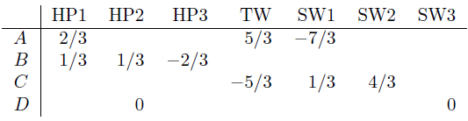
User-user collaborative filtering
Mean-centered utility matrix: subtract the means of each row
0: means no information
Negative rating: means viewers with opposite ratings will have vectors in opposite directions.
Notes:
0.380 > 0.322

Slide 31
User-user collaborative filtering
sim(A, B) = ?
sim(A, C) = ?
Notes:
0.092 > -0.559

Slide 32
User-user collaborative filtering
Finding similar users with overlapping-item mean centering
Mean-centering:
r_{x} = {1, 0, 0, 1, 3}
r_{y} = {1, 0, 2, 2, 0}
For each user x, compute mean of each ratings (ignoring missing values)
mean(rx) = (1+1+3) / 3 = 5/3
mean(ry) = (1+2+2) / 3 = 5/3
Subtract this average from each of their ratings (do nothing to the missing values)
rx= { -2/3, 0, 0, -2/3, 4/3 }
ry= { -2/3, 0, 1/3, 1/3, 0 }
Keep only items they both rate
rx= { -2/3, -2/3}
ry= { -2/3, 1/3}
Then compute cosine similarity

Slide 33
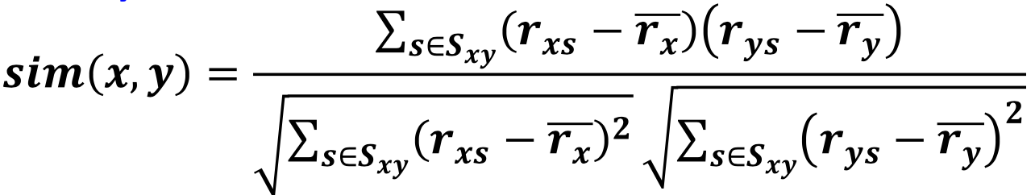
User-user collaborative filtering
Finding similar users with overlapping-item mean centering
Let r_{x} be the vector of user x’s ratings
Similarity Metric
Pearson correlation coefficient
Sxy = items rated by both users x and y

Slide 34
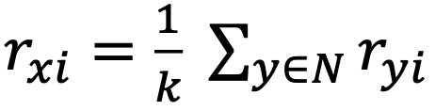
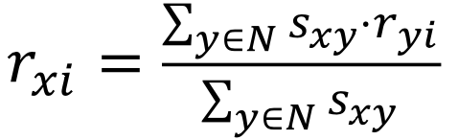
User-user collaborative filtering
Rating predictions
Let r_{x} be the vector of user x’s ratings
Let N be the set of k users most similar to x who have rated item i
Prediction for item i of user x:
Rate i as the mean of what k-people-like-me rated i
Rate i as the weighted mean of what k-people-like-me rated i

Slide 35
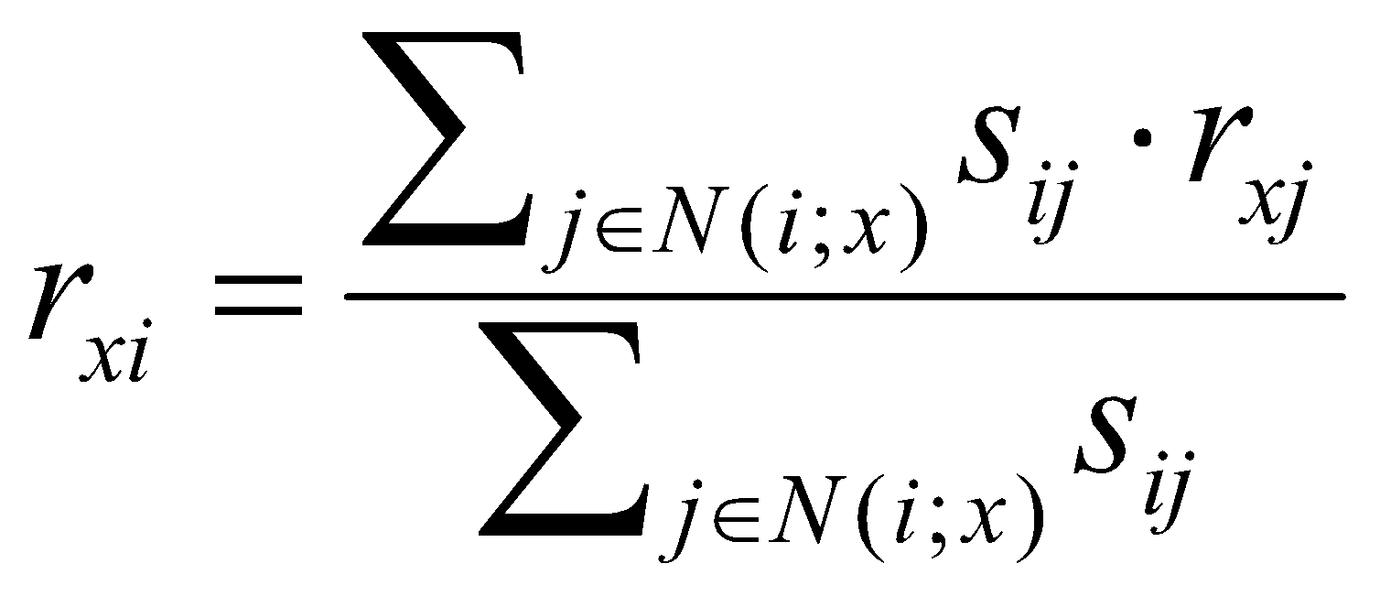
Item-Item collaborative filtering
For item i, find other similar items
Estimate rating for item i based on ratings for similar items
Can use same similarity metrics and prediction functions as in user-user model
“Rate i as the mean of my ratings for other items, weighted by their similarity to i”
s_{ij}… similarity of items i and j
r_{xj}…rating of user x on item j
N(i;x)… set items rated by x similar to i

Slide 36
Item-Item CF (|N|=2)
users
12 | 11 | 10 | 9 | 8 | 7 | 6 | 5 | 4 | 3 | 2 | 1
 | 4 |  | 5 |  |  | 5 |  |  | 3 |  | 1 | 1
3 | 1 | 2 |  |  | 4 |  |  | 4 | 5 |  |  | 2
 | 5 | 3 | 4 |  | 3 |  | 2 | 1 |  | 4 | 2 | 3
 | 2 |  |  | 4 |  |  | 5 |  | 4 | 2 |  | 4
5 | 2 |  |  |  |  | 2 | 4 | 3 | 4 |  |  | 5
 | 4 |  |  | 2 |  |  | 3 |  | 3 |  | 1 | 6
movies
- unknown rating
- rating between 1 to 5

Slide 37
Item-Item CF (|N|=2)
users
12 | 11 | 10 | 9 | 8 | 7 | 6 | 5 | 4 | 3 | 2 | 1
 | 4 |  | 5 |  |  | 5 | ? |  | 3 |  | 1 | 1
3 | 1 | 2 |  |  | 4 |  |  | 4 | 5 |  |  | 2
 | 5 | 3 | 4 |  | 3 |  | 2 | 1 |  | 4 | 2 | 3
 | 2 |  |  | 4 |  |  | 5 |  | 4 | 2 |  | 4
5 | 2 |  |  |  |  | 2 | 4 | 3 | 4 |  |  | 5
 | 4 |  |  | 2 |  |  | 3 |  | 3 |  | 1 | 6
movies
0.657
-0.83
-0.89
0.768
- estimate rating of movie 1 by user 5

Slide 38
Item-Item CF (|N|=2)
users
12 | 11 | 10 | 9 | 8 | 7 | 6 | 5 | 4 | 3 | 2 | 1
 | 2/5 |  | 7/5 |  |  | 7/5 | ? |  | -3/5 |  | -13/5 | 1
 |  |  |  |  |  |  |  |  |  |  |  | 2
 | 2 | 0 | 1 |  | 0 |  | -1 | -2 |  | 1 | -1 | 3
 |  |  |  |  |  |  |  |  |  |  |  | 4
 |  |  |  |  |  |  |  |  |  |  |  | 5
 | 7/5 |  |  | -3/5 |  |  | 2/5 |  | 2/5 |  | -8/5 | 6
movies
Neighbor selection: Identify movies similar to movie 1, rated by user 5
Here we use Pearson correlation as similarity:
1) Subtract mean rating m_{i} from each movie i
2) Compute cosine similarities between rows

Slide 39
Item-Item CF (|N|=2)
users
sim(1,m)
12 | 11 | 10 | 9 | 8 | 7 | 6 | 5 | 4 | 3 | 2 | 1
 | 4 |  | 5 |  |  | 5 | ? |  | 3 |  | 1 | 1
3 | 1 | 2 |  |  | 4 |  |  | 4 | 5 |  |  | 2
 | 5 | 3 | 4 |  | 3 |  | 2 | 1 |  | 4 | 2 | 3
 | 2 |  |  | 4 |  |  | 5 |  | 4 | 2 |  | 4
5 | 2 |  |  |  |  | 2 | 4 | 3 | 4 |  |  | 5
 | 4 |  |  | 2 |  |  | 3 |  | 3 |  | 1 | 6
1.00
0.658
0.768
movies
Compute similarity weights: s_{1,3}=0.658, s_{1,6}=0.768

Slide 40
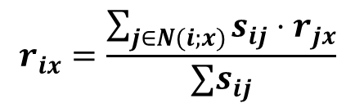
Item-Item CF (|N|=2)
users
12 | 11 | 10 | 9 | 8 | 7 | 6 | 5 | 4 | 3 | 2 | 1
 | 4 |  | 5 |  |  | 5 | 2.6 |  | 3 |  | 1 | 1
3 | 1 | 2 |  |  | 4 |  |  | 4 | 5 |  |  | 2
 | 5 | 3 | 4 |  | 3 |  | 2 | 1 |  | 4 | 2 | 3
 | 2 |  |  | 4 |  |  | 5 |  | 4 | 2 |  | 4
5 | 2 |  |  |  |  | 2 | 4 | 3 | 4 |  |  | 5
 | 4 |  |  | 2 |  |  | 3 |  | 3 |  | 1 | 6
1.00
0.658
0.768
movies
Predict by taking weighted average:
r_{1.5} = (0.658*2 + 0.768*3) / (0.658+0.768) = 2.54

Slide 41
Collaborative filtering
In practice, it has been observed that item-item often works better than user-user
Why?
Items are simpler, users have multiple tastes
People are more complex than objects

Slide 42
Collaborative filtering
Pros/Cons of Collaborative Filtering
+ Works for any kind of item
No feature selection needed
- Cold Start:
Need enough users in the system to find a match
- Sparsity:
The user/ratings matrix is sparse
Hard to find users that have rated the same items
- First rater:
Cannot recommend an item that has not been previously rated
New items, Esoteric items
- Popularity bias:
Cannot recommend items to someone with unique taste
Tends to recommend popular items

Slide 43
Hybrid Methods
Implement two or more different recommenders and combine predictions
Perhaps using a linear model
Add content-based methods to collaborative filtering
Item profiles for new item problem
Demographics to deal with new user problem

Slide 44
Remarks & Practical Tips
- Evaluation
- Error metrics
- Complexity / Speed

Slide 45
Evaluation
movies
1 | 3 | 4
 | 3 | 5 |  |  | 5
 |  | 4 | 5 |  | 5
 |  | 3
 |  | 3
2 |  |  | 2 |  | 2
 |  |  |  | 5
 | 2 | 1 |  |  | 1
 | 3 |  |  | 3
1
users

Slide 46
Evaluation
movies
1 | 3 | 4
 | 3 | 5 |  |  | 5
 |  | 4 | 5 |  | 5
 |  | 3
 |  | 3
2 |  |  | ? |  | ?
 |  |  |  | ?
 | 2 | 1 |  |  | ?
 | 3 |  |  | ?
1
users
Test Data Set

Slide 47
Evaluating Predictions
Compare predictions with known ratings
Root-mean-square error (RMSE)
Precision at top 10: % of relevant items in top 10

Slide 48
Problems with Error Measures
Narrow focus on accuracy sometimes misses the point
Prediction Diversity
Prediction Context
Order of predictions
In practice, we care only to predict high ratings:
RMSE might penalize a method that does well for high ratings and badly for others

Slide 49
Collaborative Filtering: Complexity
Too expensive to do at runtime
We already know how to do this!
Near-neighbor search in high dimensions (LSH)
Clustering
Dimensionality reduction

Slide 50
Tip: Add Data
Leverage all the data
Don’t try to reduce data size in an effort to make fancy algorithms work
Simple methods on large data do best
Add more data
e.g., add IMDB data on genres

